Slide 1
capillar.it
consumption-centric mobility solutions
july 9th Physical Internet Award | IPIC 2019 London
Javi Esquillor

Slide 2
contributions w/i Physical Internet
CAPILLAR.IT
CAPILLAR.IT | july 9th IPIC 2019 London

Slide 3
this we bring
→ physical² internet business
→ GS1 penetration turnaround project
→ capillary logistics networks
→ City Line, ENTRUST
CAPILLAR.IT | july 9th IPIC 2019 London
Notes:
PI2 business
IT architectures centralization vs optimization; real estate(s)
businesses conventional, syncrobusiness (hosting, data)
customization to next levels (including finance)

Slide 4
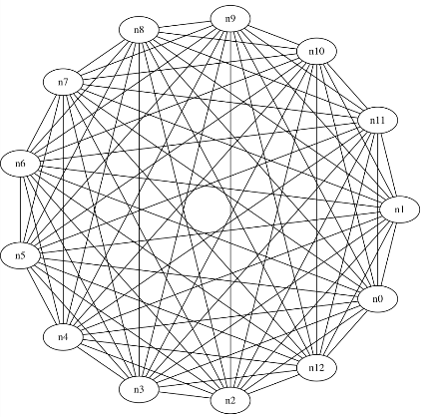
business synchronization
Inspection
Client
Customer
...
Logistics
Private Platform
Sector Association
Public Platform
Wholesaler
Private Logistics Platform
Mutualized transport
Public Central Market
Articulation
Analytics
API
API
API
API
API
DNA
DNA
DNA
DNA
DNA
DHT
DHT
DHT
DHT
DHT
bridging allows agents to share data at APP layer
CAPILLAR.IT | july 9th IPIC 2019 London

Slide 5
conventional market | new sale channels
full traceability
through mutualized tools
fully owned by themselves p2p
stepping business into digital economy
data | hosting | cryptocurrency
CAPILLAR.IT | july 9th IPIC 2019 London
Notes:
through mutualized tools
urban distribution service | full smart e-fleet & containers
distributed apps | naturally interoperable
ad hoc distributed IT infrastructure | fully own by themselves p2p
stepping business into digital economy
data | exploit & trade data
hosting | business integrity & earnings
cryptocurrency | opening consumption options & funding

Slide 6
hApp 1 | mutualized urban distribution
API
integration
Logistics
Wholesaler
HORECA
Retailer
Inspection
Urban mobility
Platform
Security
Application Layer
Logistics Agent
Cargo Agent
Inspection Agent
p2p
validation
Data Hash Table
agent centric
DHT
integrity
CAPILLAR.IT | july 9th IPIC 2019 London
Notes:
it is a combination of bit torrent + git + digital signature that grants data & business integrity (own and control of data & IT infrastructure) with natural interoperability & full scalability

Slide 7
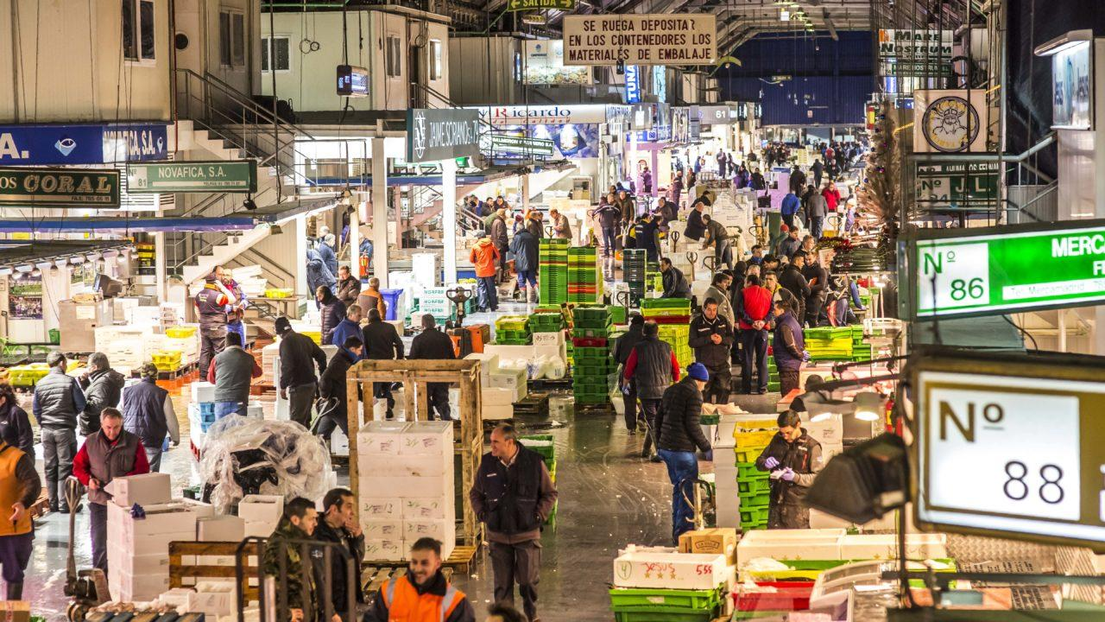
this is today
CAPILLAR.IT
CAPILLAR.IT | july 9th IPIC 2019 London
CAPILLAR.IT | july 9th IPIC 2019 London

Slide 8
this is today
this is today
CAPILLAR.IT
CAPILLAR.IT | july 9th IPIC 2019 London
CAPILLAR.IT | july 9th IPIC 2019 London

Slide 9
this is today
→ 2nd largest mkt worldwide | 1st diverse portfolio
→ 100.000 tn / year urban distribution
CAPILLAR.IT
CAPILLAR.IT | july 9th IPIC 2019 London

Slide 10
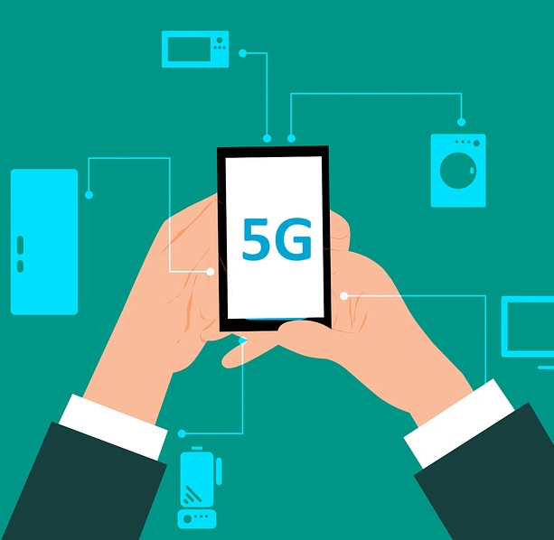
whilst
Cloud computing business at 5% of its potential
CAPILLAR.IT
CAPILLAR.IT | july 9th IPIC 2019 London

Slide 11
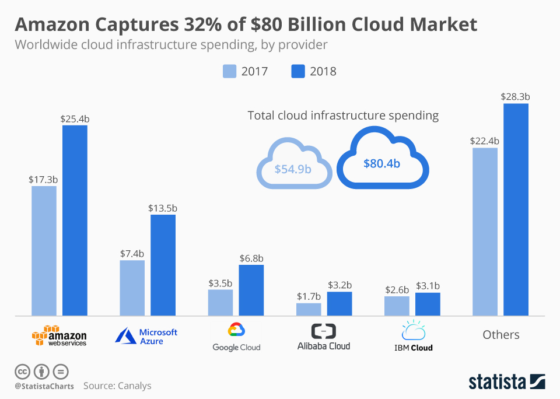
CAPILLAR.IT | july 9th IPIC 2019 London
Notes:
32% - 17% - 8% - 4% - 4%

Slide 12
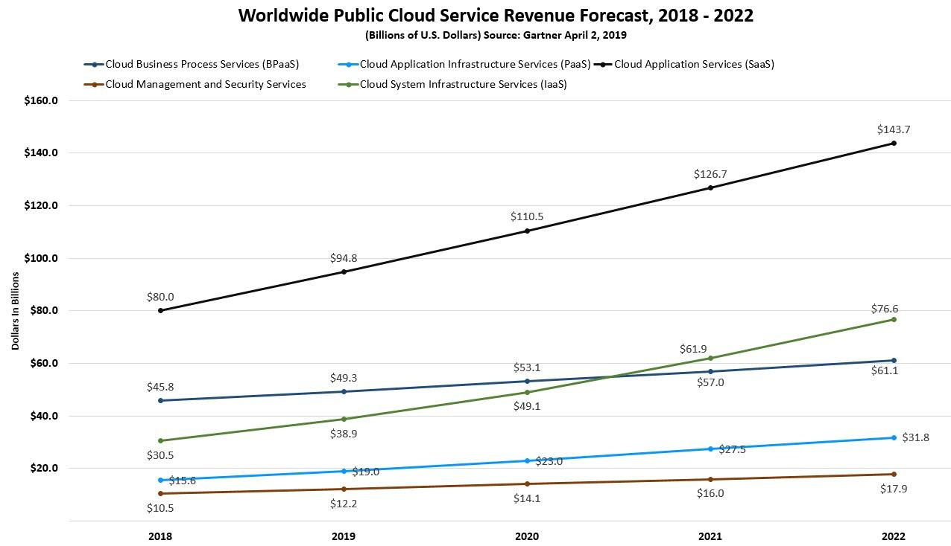
CAPILLAR.IT
CAPILLAR.IT | july 9th IPIC 2019 London
Notes:
SaaS $25 billions in 2015
expected (total) market cap 1 to 4 millions of millions

Slide 13
CAPILLAR.IT
CAPILLAR.IT | july 9th IPIC 2019 London

Slide 14
Dapp, DApp Explorers
Application layer
Decentralized DNS
Decentralized Query
Blockchain Level - State machine, Layer 2, interoperability, consensus, etc
Infrastructure layer
Decentralized Storage, Computing
Decentralized Networking & Transport
CAPILLAR.IT
CAPILLAR.IT | july 9th IPIC 2019 London

Slide 15
Dapp, DApp Explorers
Application layer
Decentralized DNS
Decentralized Query
Blockchain Level - State machine, Layer 2, interoperability, consensus, etc
Infrastructure layer
digital real estate
Decentralized Storage, Computing
Decentralized Networking & Transport
CAPILLAR.IT
CAPILLAR.IT | july 9th IPIC 2019 London

Slide 16
conventional logistic value chain
T&L₁
SHIPPER
LOGISTICS
CUSTOMER
T&L_{n}
CAPILLAR.IT
CAPILLAR.IT
CAPILLAR.IT | july 9th IPIC 2019 London

Slide 17
Amazon value chain
SHIPPER
LOGISTICS
market
data
cloud
CUSTOMER
CAPILLAR.IT
CAPILLAR.IT | july 9th IPIC 2019 London

Slide 18
capillar.it value chain
SHIPPER
T&L_{n}
data
goods market
cloud
S_{n}
LOGISTICS
goods market
data market
cloud market
CUSTOMER
C_{n}
open markets & p2p
CAPILLAR.IT
CAPILLAR.IT
CAPILLAR.IT | july 9th IPIC 2019 London

Slide 19
cases
CAPILLAR.IT
CAPILLAR.IT | july 9th IPIC 2019 London

Slide 20
CASE 1
case 1
CAPILLAR.IT
CAPILLAR.IT
CAPILLAR.IT | july 9th IPIC 2019 London

Slide 21
case 1
Madrid
CAPILLAR.IT
CAPILLAR.IT
CAPILLAR.IT | july 9th IPIC 2019 London

Slide 22
case 1
100.000 Tn / year
B2B2C with e-commerce
new channels | products
| processes | containers
CAPILLAR.IT
CAPILLAR.IT
CAPILLAR.IT | july 9th IPIC 2019 London
Notes:
we are doing that here, learning from what just happened (Amazon, 1st fresh market worldwide on Prime)
regulation(s)
→ sales | traceability digital
→ distribution | restrictions
segment (s)
→ in the verge of digital exclusion
→ fragmentation
→ consumption trends

Slide 23
case 1
4 phases
mutualized logistics & procedures
5 contributions
from digital exclusion to set the path
→ customization trends
→ business models
→ regulation & verification
CAPILLAR.IT
CAPILLAR.IT
CAPILLAR.IT | july 9th IPIC 2019 London
Notes:
GS1 penetration | data & IT business model | urban traceability vs blockchain | business synchronization
--> pi1 containerization to integrate & optimize vs fragmentation
--> pi2 capture | produce (adapt EPICS) | share
--> pi1&2 methodology & success of standards penetration: from the verge of exclusion to lead

Slide 24
case 2
Namur
BENELUX
CAPILLAR.IT
CAPILLAR.IT | july 9th IPIC 2019 London

Slide 25
case 2
a scooter is a 18kg parcel
Namur
BENELUX
CAPILLAR.IT
CAPILLAR.IT | july 9th IPIC 2019 London

Slide 26
CASE 2
hot spot
HUB
hot spot
Operational beyond cycle hunting
Business development extend portfolio & geo
Business model(s) systematise & scalability
hot spot
delivery
pick-up
CAPILLAR.IT
CAPILLAR.IT | july 9th IPIC 2019 London
Notes:
Operational. beyond cycle hunting
Onfield analytics
Synergy of flows
Business development. flows & networks
Extend portfolio. customers, data sets, KPIs
Geo-extend
Business model(s). systematise & scalability
Vision. synergies
Model(s). topology of cities → Design&Deploy&Dev
the next customization level

Slide 27
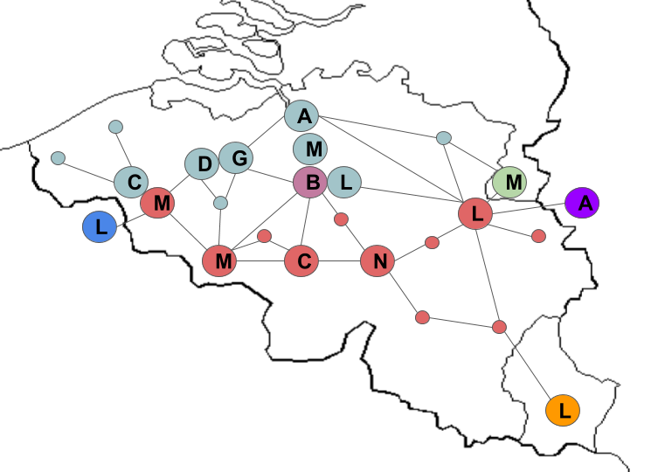
CASE 2
mutual scale up
50 companies
30 cities
10-20 to scale up
a scooter is a 18kg parcel
CAPILLAR.IT
CAPILLAR.IT
CAPILLAR.IT | july 9th IPIC 2019 London

Slide 28
CASE 3
mobility for consumption
mixed for people and goods
with subsequent synergies in back & front end
→ e-commerce & last delivery
come to pick up & experience + we arrive to (deliver) your experience
→ eco restaurant
decarbonize (suppliers & customers) last miles
CAPILLAR.IT
CAPILLAR.IT
CAPILLAR.IT | july 9th IPIC 2019 London

Slide 29
mobility from consumption
business intelligence | shape & manage flows
providing smart holistics systems
→ e-fleets | architectureS & real estateS | SW
→ size, design, test, deploy, scale up
CAPILLAR.IT
CAPILLAR.IT

Slide 30
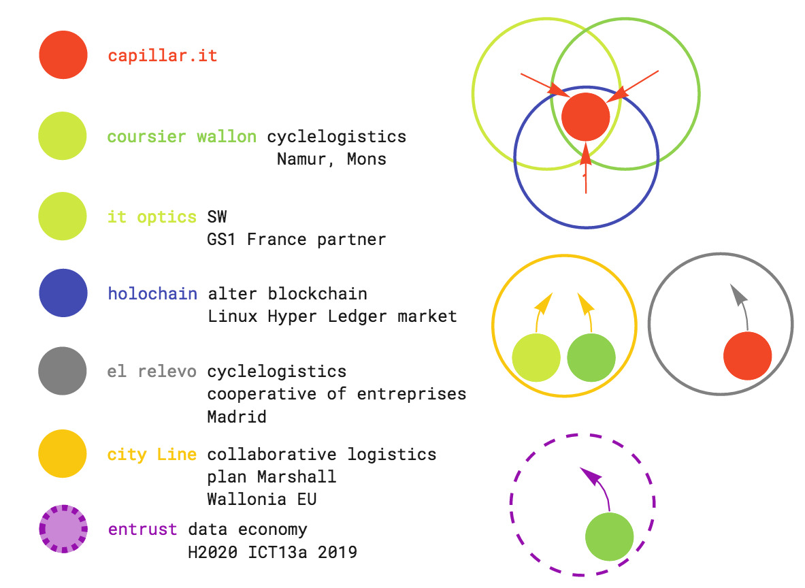
who & where
CAPILLAR.IT
CAPILLAR.IT
CAPILLAR.IT | july 9th IPIC 2019 London

Slide 31
a Physical Internet company
Physical² Internet
our field of work
contributing to develop the Physical part of Internet through logistics
CAPILLAR.IT
CAPILLAR.IT
CAPILLAR.IT | july 9th IPIC 2019 London
Notes:
Physical Internet
Bringing digital networks logics, performance & properties to the non-digital part of logistics

Slide 32
the playground | what makes us different
CAPILLAR.IT
CAPILLAR.IT | july 9th IPIC 2019 London

Slide 33
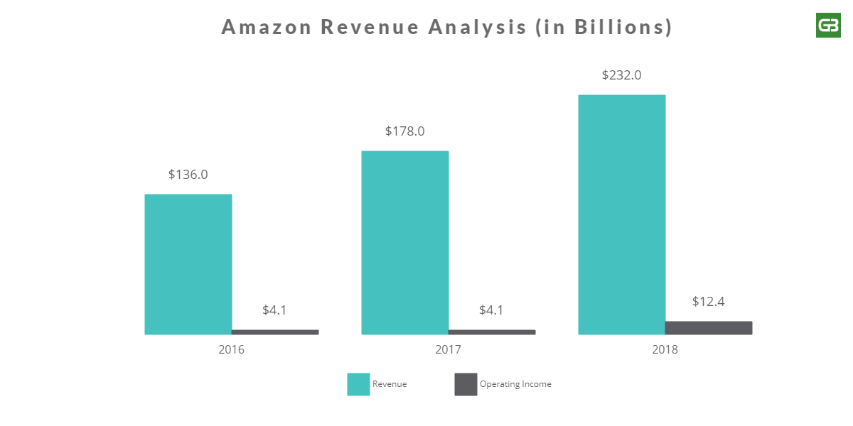
CAPILLAR.IT
CAPILLAR.IT | july 9th IPIC 2019 London

Slide 34
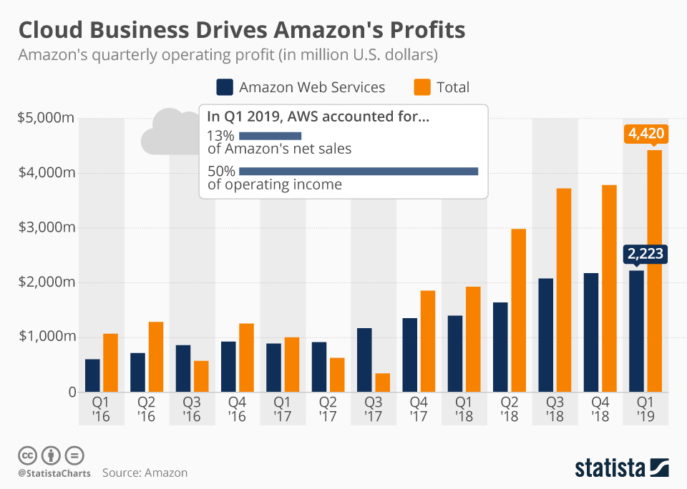
CAPILLAR.IT
CAPILLAR.IT | july 9th IPIC 2019 London

Slide 35
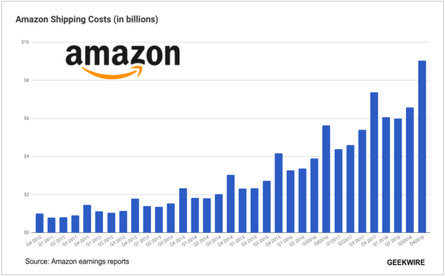
CAPILLAR.IT
CAPILLAR.IT | july 9th IPIC 2019 London

Slide 36
the playground
logistics spent > Inditex turnover worldwide (REF 3) $29.793 millions
60% of profits from cloud computing
CAPILLAR.IT
CAPILLAR.IT | july 9th IPIC 2019 London

Slide 37
the playground
CAPILLAR.IT
CAPILLAR.IT | july 9th IPIC 2019 London
Notes:
this question can be misleading from net income point of view (margins in logistics won’t allow for the same). From functional point of view, logistics is next step, even more important as structure to operate the whole thing

Slide 38
the playground
another playground
→ customization disruption
→ in-synergies business model
→ digital real estate & logistics
CAPILLAR.IT
CAPILLAR.IT
CAPILLAR.IT | july 9th IPIC 2019 London

Slide 39
the playground
CAPILLAR.IT
CAPILLAR.IT
CAPILLAR.IT | july 9th IPIC 2019 London

Slide 40
the playground
CAPILLAR.IT
CAPILLAR.IT
CAPILLAR.IT | july 9th IPIC 2019 London

Slide 41
the playground
CAPILLAR.IT
CAPILLAR.IT
CAPILLAR.IT | july 9th IPIC 2019 London

Slide 42
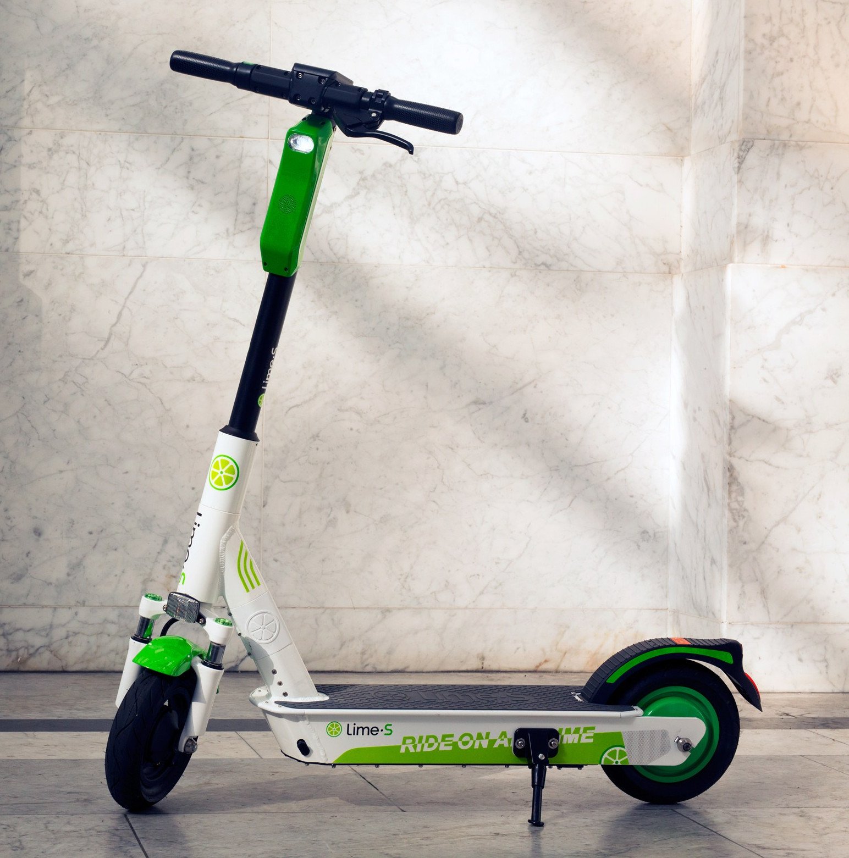
the playground
capillarity
CAPILLAR.IT
CAPILLAR.IT
CAPILLAR.IT | july 9th IPIC 2019 London

Slide 43
in the customer-centric value chains we
shape flows
providing smart holistics systems
with capillary business intelligence
orchestrating synergies
and technology
triggering next wave of disruptive business
CAPILLAR.IT
CAPILLAR.IT
CAPILLAR.IT | july 9th IPIC 2019 London

Slide 44
the playground | what makes us different
CAPILLAR.IT
CAPILLAR.IT | july 9th IPIC 2019 London

Slide 45
what makes us different
→ capillary logistics
→ capillary empowered data analytics
→ holochain technology
CAPILLAR.IT
CAPILLAR.IT
CAPILLAR.IT | july 9th IPIC 2019 London

Slide 46
what makes us different
→ capillary logistics 4 axes
human | front & back ends
vehicles
built infrastructure urban real estate
digital technology | SW & infrastructure
CAPILLAR.IT
CAPILLAR.IT
CAPILLAR.IT | july 9th IPIC 2019 London

Slide 47
what makes us different
digital infrastructure
→ architecture fits performance
→ agents benefit from it
digital real estate
CAPILLAR.IT
CAPILLAR.IT
CAPILLAR.IT | july 9th IPIC 2019 London
Notes:
IT systems are designed to picks and valleys: monetise thru dynamic market

Slide 48
what makes us different
distributed Physical Internet
CAPILLAR.IT
CAPILLAR.IT
CAPILLAR.IT | july 9th IPIC 2019 London
Notes:
IT systems are designed to picks and valleys: monetise thru dynamic market

Slide 49
what makes us different
HOLOCHAIN | Linux of Hyper Ledger market
→ DATA STRUCTURE for distributed Apps
→ SUPPORT mutual credit & non monetary ccys
→ POWERED by HOLO cloud hosting AirBnb
CAPILLAR.IT
CAPILLAR.IT | july 9th IPIC 2019 London
Notes:
DATA STRUCTURE for distributed Apps
edge computing in distributed hosting systems bit torrent + git + digital signature
INSTEAD OF CURRENCY supports mutual credit and non monetary currencies
POWERED by HOLO cloud hosting AirBnb
native, mutual credit HOLO FUEL → double backing with real economy projects
performance | architecture

Slide 50
hApp 1 | mutualized urban distribution
API
encryption
Logistics
Wholesaler
HORECA
Retailer
Inspection
Urban mobility
Platform
Security
Application Layer
Logistics Agent
Cargo Agent
Inspection Agent
p2p
validation
Data Hash Table
agent centric
DHT
verification
CAPILLAR.IT | july 9th IPIC 2019 London
Notes:
it is a combination of bit torrent + git + digital signature that grants data & business integrity (own and control IT infrastructure) with natural interoperability & full scalability

Slide 51
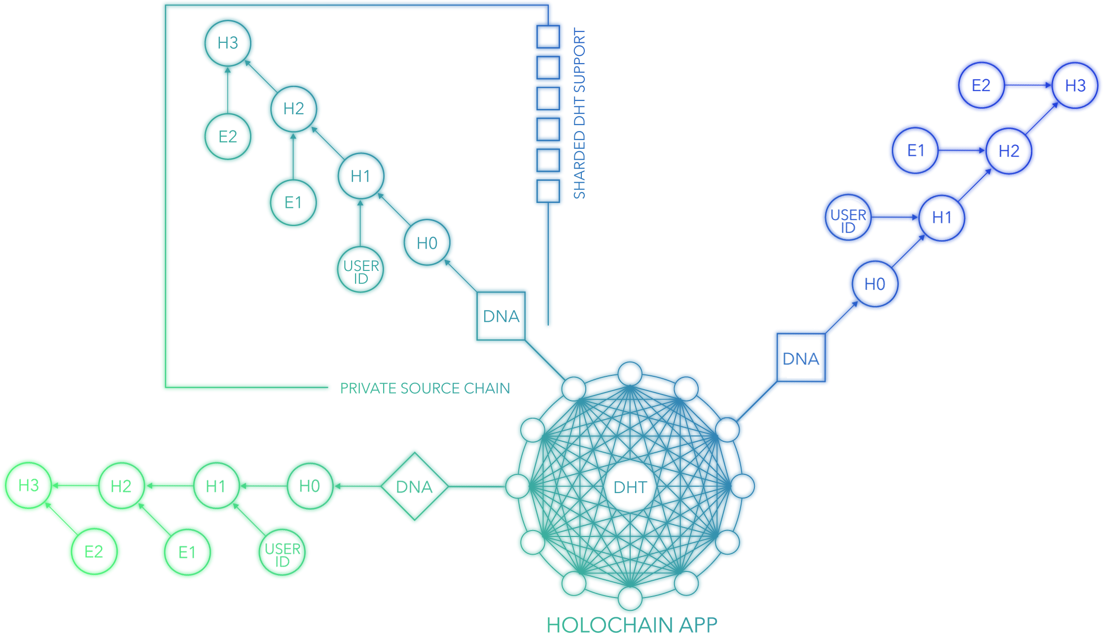
capillary is in the chain
Wholesaler
Inspection
Logistics
CAPILLAR.IT
CAPILLAR.IT | july 9th IPIC 2019 London
Notes:
base to size, design to perform, integrity, control, interoperability that extends to mutual credit

Slide 52
what makes us different
HOLOCHAIN powered by HOLO
digital real estate optimized for
→ business integrity data & hosting control & ownership
→ interoperability
→ scalability
CAPILLAR.IT
CAPILLAR.IT
CAPILLAR.IT | july 9th IPIC 2019 London

Slide 53
our difference
next level of customization
opens and enables agents to enter
new businesses driven by digitalization
→ data
→ hosting | cloud airBnB
→ funding | new crypto interactions
CAPILLAR.IT
CAPILLAR.IT
CAPILLAR.IT | july 9th IPIC 2019 London

Slide 54
our difference
new crypto interactions | open funding
vs
just spending
CAPILLAR.IT
CAPILLAR.IT
CAPILLAR.IT | july 9th IPIC 2019 London

Slide 55
our difference
new crypto interactions | open funding
vs
just spending
CAPILLAR.IT
CAPILLAR.IT
CAPILLAR.IT | july 9th IPIC 2019 London

Slide 56
our difference
new crypto interactions | open funding
vs
just spending
CAPILLAR.IT
CAPILLAR.IT | july 9th IPIC 2019 London

Slide 57
our difference
with zero transparency | control | access to make business
CAPILLAR.IT
CAPILLAR.IT
CAPILLAR.IT | july 9th IPIC 2019 London

Slide 58
ownership & interoperability, by nature
SHIPPER
T&L_{n}
data
goods market
cloud
S_{n}
LOGISTICS
goods market
data market
cloud market
CUSTOMER
C_{n}
recursivity thru projects
seeds?
CAPILLAR.IT
CAPILLAR.IT
CAPILLAR.IT | july 9th IPIC 2019 London

Slide 59
capillar.it
july 9th Physical Internet Award | IPIC 2019 London
| project@capillar.it

